Slide 1


Slide 2
Areas of application of nuclear devices in exploration
Creating a big hole
Natural Gas Exploration
Mining Oil Shale

Slide 3
Creating a big hole
A fission explosion is a cheap source of energy. This energy is used for earth moving , subject to restriction imposed by radioactivity. The problems associated with surface explosions are much more serious as compared to u/g explosions.

Slide 4
Mining Oil Shale
To overcome the increasing prices of fuel we can convert carbon rich sedimentary rocks known as oil shale, into liquid fuels.
it costs a lot of energy and money to move all that rock and extract the useful stuff . Solution: thermonuclear explosions.

Slide 5
Thermonuclear Devices
Thermonuclear devices still required a small fission trigger but, since the thermonuclear fuel consisted of relatively cheap deuterium and lithium and produced almost no long-lived radioactive by-products, they offered the possibility of an order of magnitude decrease in both the cost of an explosive and the amount of radioactivity associated with a given total yield

Slide 6
Method of using Nuclear devices in u/g mining.
The cost of mining operations , materials and labour in crushing is about 30% of total cost of winning.
To reduce these costs one can use cheaper, compact and extremely powerful nuclear devices.
A large explosion takes place, the cavity formed in the explosion caves, and the cave-in tube formed whose dimension depends upon the natural jointing of the rocks.
This cave-in tube is filled with rock debris which can be mined by normal methods.

Slide 7
A smaller cave-in tube would not allow the rock beyond the tube to move for which we may need to drill holes.
It would be more economical if very large dia. cave-in tubes are made so that caving propagates several hundred kilometers upwards.
The fragmented ore in this case amounts to thousands of cubic metres and utilization of nuclear devices becomes profitable.

Slide 8
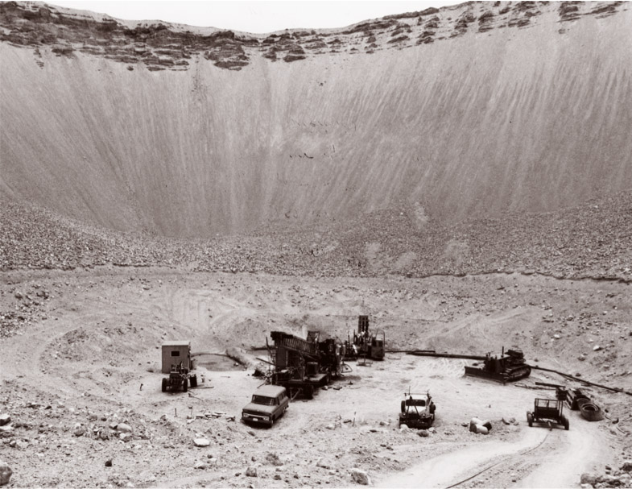

Slide 9
Case study of use of nuclear device in o/c mining
It is planned to use groups of nuclear charges for removing the overburden from a large deposit of non-ferrous metals.
The climatic, geographic and economic conditions of the region are those of extreme Northern territories, including permafrost to a depth of 650 m.
The region is also characterized by frequent earthquakes and landslides.
The population density is very low (1 inhabitant/20 km2) and the deposit is remote from existing railways and roads.
The mineralization is confined to a sandstone formation, the extent of that part containing minerals in commercially interesting amounts being 11-12 km.
About 70% of the ore is to be mined by opencast methods involving the removal of 2300 million cubic metres of overburden.

Slide 10
Excavation work on this scale by conventional methods would require a great deal of heavy mining and earth-moving equipment. However, because of the severe climatic conditions and inhospitable nature of the region and its remoteness from principal transport routes and sources of electric power, it is possible and even advantageous to carry out such work with the help of nuclear explosions.
By means of multiple explosions, 900 million cubic metres out of a total of 2300 million cubic metres of overburden will be displaced from the areas scheduled for mining, with an anticipated saving in costs of 1000 million roubles.
In order to determine precisely the basic parameters of explosions in such formation a test blast with a special programme of experimentation is planned.

